Slide 1
NoSQL

Slide 2
Types of Data
Data can be broadly classified into four types:
Structured Data: Have a predefined model, which organizes data into a form that is relatively easy to store, process, retrieve and manage
e.g. relational data
Unstructured Data: Opposite of structured data
e.g., Flat binary files with text, video or audio
Note: data is not completely devoid of a structure (e.g., an audio file may still have an encoding structure and some metadata associated with it)
Dynamic Data: Data that changes relatively frequently
e.g. office documents and transactional entries in a financial database
Static Data: Opposite of dynamic data
e.g. medical imaging data from MRI or CT scans

Slide 3
Why Classifying of Data?
Segmenting data into one of the following 4 quadrants can help in designing and developing a pertaining storage solution
Relational databases are usually used for structured data
File systems or NoSQL databases can be used for (static), unstructured data (more on these later)
Dynamic
Static
Media Production, eCAD, mCAD, Office Docs
Media Archive, Broadcast, Medical Imaging
Unstructured
Transaction Systems, ERP, CRM
BI, Data Warehousing
Structured

Slide 4
The Relational Model
E. F. Codd, a British computer scientist developed the relational model while at IBM San Jose Research Laboratory
“A Relational Model of Data for Large Shared Data Banks,” E.F. Codd, Communications of the ACM, Vol. 13, No. 6, June, 1970.
“Further Normalization of the Data Base Relational Model,” E.F. Codd, Data Base Systems, Proceedings of 6th Courant Computer Science Symposium, May, 1971.
“Relational Completeness of Data Base Sublanguages,” E.F. Codd, Data Base Systems, Proceedings of 6th Courant Computer Science Symposium, May, 1971.

Slide 5
The Relational Model
“Employee”
ID Last-Name Date-of-Birth Job-Category
15394 Jones 11/03/75 Software
21621 Smith 06/24/69 Management
17852 Brown 08/14/72 Hardware
32904 Carson 10/29/64 Software
The basic data model:
Relations, tuples, attributes, domains
Primary & foreign keys
Normal forms
Query model:
Relational algebra – cartesian product, selection, projection, union, set-difference
Relational calculus
A primary theme:
Physical data independence

Slide 6
Relational Database Management Systems
Database Management Systems Based on the Relational Model:
System R – IBM research project (1974)
Ingres – University of California Berkeley (early 1970’s)
Oracle – Rational Software, now Oracle Corporation (1974)
SQL/DS – IBM’s first commercial RDBMS (1981)
Informix – Relational Database Systems, now IBM (1981)
DB2 – IBM (1984)
Sybase SQL Server – Sybase, now SAP (1988)

Slide 7
Relational Databases
Benefits of Relational Databases:
Designed for all purposes
ACID compliance (Atomicity, Consistency, Isolation, Durability)
Strong consistency, concurrency, recovery
Mathematical Background
Standard Query Language (SQL)
Lots of tools to use with i.e. reporting services, entity frameworks, …

Slide 8
Structure Query Language (SQL)
SQL is a language for querying relational databases.
Developed at IBM San Jose Research Laboratory, early 1970’s, for System R
Credited to Donald D. Chamberlin and Raymond F. Boyce
Based on relational algebra and tuple calculus
Originally called SEQUEL
Language Elements: Clauses, expressions, predicates, queries, statements, transactions, operators, nesting etc.
select o_orderpriority, count(*) as order_count
from orders
where o_orderdate >= date '[DATE]‘ and o_orderdate < date '[DATE]' + interval '3' month
and exists (select * from lineitem
where l_orderkey = o_orderkey and l_commitdate < l_receiptdate)
group by o_orderpriority
order by o_orderpriority;

Slide 9
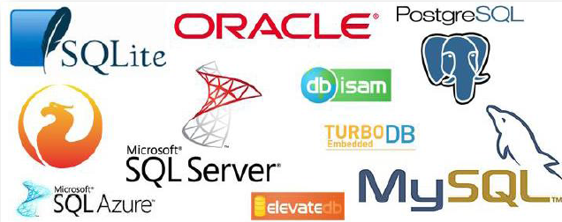
Structure Query Language Databases

Slide 10
Relational Query Language
Other Relational Query Languages.
Datalog
QUEL
Query By Example (QBE)
SQL variations
shell scripts, with relational extensions

Slide 11
Scaling Traditional Databases
Relational databases → mainstay of business
Web-based applications caused spikes
explosion of social media sites (Facebook, Twitter) with large data needs
rise of cloud-based solutions such as Amazon S3 (simple storage solution)
Hooking RDBMS to web-based application becomes trouble

Slide 12
Scaling Traditional Databases
Traditional RDBMSs can be either scaled:
Vertically (or Up): Best way to provide ACID and rich query model is to have the dataset on a single machine
Can be achieved by hardware upgrades (e.g., faster CPU, more memory, or larger disk)
Limited by the amount of CPU, RAM and disk that can be configured on a single machine (Dataset is just too big!)
Horizontally (or Out): adding more machines is a better choice
Different approaches for horizontal scaling (multi-node database)
Master/Slave
sharding (Partitioning)

Slide 13
Scaling out RDBMS: Master/Slave
Master/Slave
All writes are written to the master
All reads performed against the replicated slave databases
Critical reads may be incorrect as writes may not have been propagated down
Large datasets can pose problems as master needs to duplicate data to slaves
Limited by the Read-to-Write ratio and communication overhead

Slide 14
Scaling out RDBMS: Sharding
Sharding (partitioning): Allows concurrent (or parallel) accesses
Scales well for both reads and writes
Not transparent, application needs to be partition-aware
Can no longer have relationships/joins across partitions
Loss of referential integrity across shards
Input data: A large file
Machine 1
Machine 2
Machine 3
Chunk1 of input data
Chunk3 of input data
Chunk5 of input data
Chunk2 of input data
Chunk4 of input data
Chunk5 of input data
E.g., Chunks 1, 3 and 5 can be accessed in parallel

Slide 15
Other ways to scale out RDBMS
Multi-Master replication
INSERT only, not UPDATES/DELETES
No JOINs, thereby reducing query time
This involves de-normalizing data
In-memory databases

Slide 16
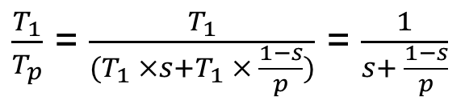
Amdahl’s Law
How much faster will a parallel program run?
Suppose that the sequential execution of a program takes T₁ time units and the parallel execution on p processors/machines takes T_{p} time units
Suppose that out of the entire execution of the program, s fraction of it is not parallelizable while 1-s fraction is parallelizable
Then the speedup (Amdahl’s formula):

Slide 17
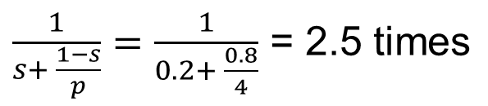
Amdahl’s Law: An Example
Suppose that:
80% of your program can be parallelized
4 machines are used to run your parallel version of the program
The speedup you can get according to Amdahl’s law is:
Although you use 4 processors you cannot get a speedup more than 2.5 times!

Slide 18
Real vs. Actual cases
Amdahl’s argument is too simplified
In reality, communication overhead and potential workload imbalance exist upon running parallel programs
Serial
20
80
Serial
20
80
Parallel
20
20
Parallel
20
20
Process 1
Process 1
Process 2
Process 2
Cannot be parallelized
Process 3
Process 3
Cannot be parallelized
Can be parallelized
Process 4
Can be parallelized
Process 4
Communication overhead
Load Unbalance
1. Parallel Speed-up: An Ideal Case
2. Parallel Speed-up: An Actual Case

Slide 19
Some Guidelines
Here are some guidelines to effectively benefit from parallelization:
Maximize the fraction of your program that can be parallelized
Balance the workload of parallel processes
Minimize the time spent for communication

Slide 20

Why Replicating Data?
Replicating data across servers helps in:
Avoiding performance bottlenecks
Avoiding single point of failures
And, hence, enhancing scalability and availability
Main Server
Replicated Servers

Slide 21
But, Consistency Becomes a Challenge
An example:
In an e-commerce application, the bank database has been replicated across two servers
Maintaining consistency of replicated data is a challenge
Event 1 = Add $1000
Event 2 = Add interest of 5%
1
2
Bal=2000
4
Bal=2100
Bal=1000
3
Bal=1000
Bal=1050
Bal=2050
Replicated Database

Slide 22

The Two-Phase Commit Protocol
The two-phase commit protocol (2PC) can be used to ensure atomicity and consistency
Phase I: Voting
VOTE_REQUEST
VOTE_COMMIT
Participant 1
Database Server 1
VOTE_REQUEST
VOTE_COMMIT
Coordinator
Participant 2
Database Server 2
VOTE_COMMIT
VOTE_REQUEST
Participant 3
Database Server 3

Slide 23
The Two-Phase Commit Protocol
The two-phase commit protocol (2PC) can be used to ensure atomicity and consistency
Phase II: Commit
GLOBAL_COMMIT
LOCAL_COMMIT
Participant 1
Database Server 1
GLOBAL_COMMIT
LOCAL_COMMIT
Coordinator
Participant 2
Database Server 2
GLOBAL_COMMIT
LOCAL_COMMIT
“Strict” consistency, which limits scalability!
Participant 3
Database Server 3

Slide 24
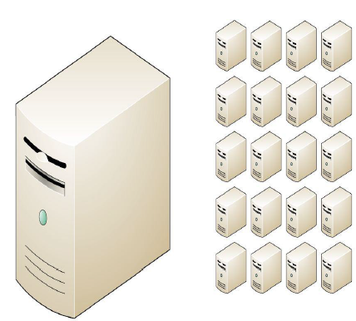
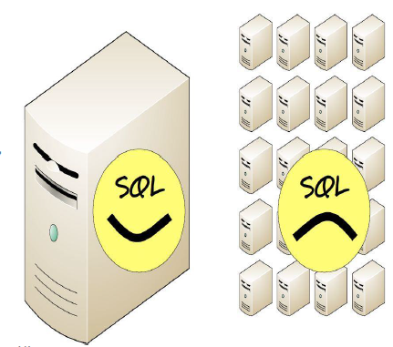
NoSQL why, what and when?
BUT …
Relational databases were not built for distributed applications
Because
Joins are expensive
Hard to scale horizontally
Impedance mismatch occurs
Expensive (Product cost, Hardware, Maintenance)
And it’s weak in:
Speed (performance)
High Availability
Partition tolerance

Slide 25
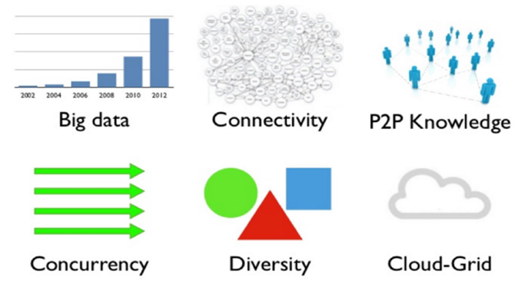
Why NoSQL now?
Answer: New Trends

Slide 26
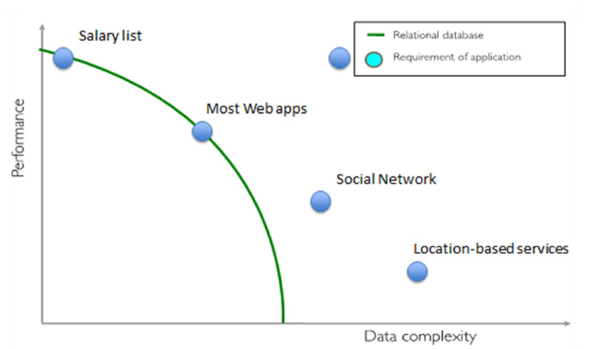
Side Note: RDBMS performance

Slide 27
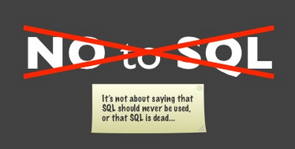
What is NoSQL?
The Name:
Stands for Not Only SQL
The term NOSQL was introduced by Carl Strozzi in 1998 to name his file-based database
It was again re-introduced by Eric Evans when an event was organized to discuss open source distributed databases
Eric states that “… but the whole point of seeking alternatives is that you need to solve a problem that relational databases are a bad fit for. …”

Slide 28
What is NoSQL?
NoSQL databases is an approach to data management that is useful for very large sets of distributed data
A flexible database used for big data and real-time web-apps
A NoSQL database provides a mechanism for storage and retrieval of data that employs less constrained consistency models than traditional relational databases. Consistency is traded in favour of Availability
NoSQL systems are also referred to as “NotonlySQL” to emphasize that they do not prohibit Structured Query Language (SQL), in fact allow SQL-like query languages to be used

Slide 29
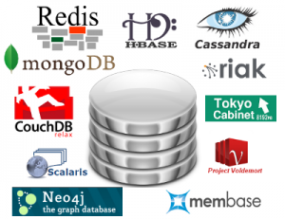
What is NoSQL?
Key features (advantages):
non-relational
don’t require schema
data are replicated to multiple nodes (so, identical & fault-tolerant) and can be partitioned:
down nodes easily replaced
no single point of failure
horizontal scalable
cheap, easy to implement (open-source)
massive write performance
fast key-value access

Slide 30
What is NoSQL?
Disadvantages:
Don’t fully support relational features
no join, group by, order by operations (except within partitions)
no referential integrity constraints across partitions
No declarative query language (e.g., SQL) → more programming
Relaxed ACID (see CAP theorem) → fewer guarantees
No easy integration with other applications that support SQL

Slide 31
Characteristics of NoSQL databases
NoSQL avoids
Overhead of ACID transactions
Complexity of SQL query
Burden of up-front schema design
DBA presence
Transactions (It should be handled by application layer)
Provides
Easy and frequent changes to DB
Fast development
Large data volumes (e.g. Google)
Schema less

Slide 32
When and when not to use NoSQL?
When/Why?
When traditional RDBMS model is too restrictive (flexible schema)
When ACID support is not “really” needed
Object-to-Relational (O/R) impedance
Because RDBMS is neither distributed not scalable by nature
Logging data from distributed sources
Storing Events / temporal data
Temporary Data (Shopping Carts / Wish lists / Session Data)
When Not?
Financial Data
Data requiring strict ACID compliance
Business Critical Data

Slide 33
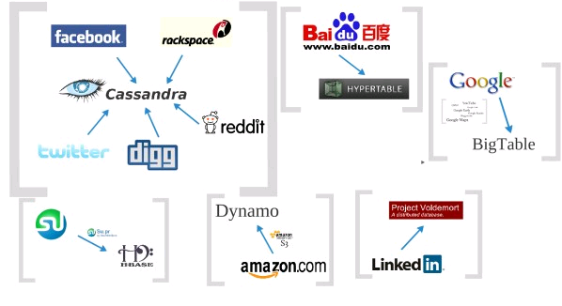




Who is using them?

Slide 34
3 Major papers for NoSQL
Three major papers were the “seeds” of the NOSQL movement:
BigTable (Google)
DynamoDB (Amazon)
Ring partition and replication
Gossip protocol (discovery and error detection)
Distributed key-value data stores
Eventual consistency
CAP Theorem

Slide 35
The Perfect Storm
Large datasets, acceptance of alternatives, and dynamically-typed data has come together in a “perfect storm”
Not a backlash against RDBMS
SQL is a rich query language that cannot be rivaled by the current list of NOSQL offerings

Slide 36
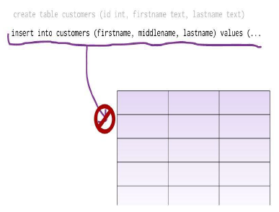
What is a schema-less data model?
In relational databases:
You cannot add a record which does not fit the schema
You need to add NULLs to unused items in a row
We should consider the datatypes. i.e. you cannot add a string to an integer field
You cannot add multiple items in a field (You should create another table: primary key, foreign key, joins, normalization, … !!!)

Slide 37
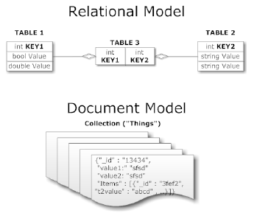
What is a schema-less data model?
In NoSQL databases:
There is no schema to consider
There is no unused cell
There is no data type (implicit)
Most of the considerations are done in application layer
We gather all items in an aggregate (document)

Slide 38
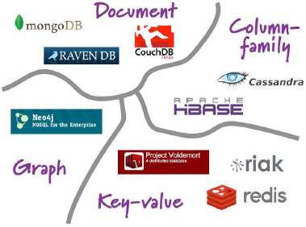
Aggregate Data Models
NoSQL databases are classified in four major data models:
Key-Value Stores
Column Databases
Graph Database
Document Databases
Each DB has its own query language

Slide 39
NoSQL: Aggregate
The relational model divides the information that we want to store into tuples (rows): this is a very simple structure for data
Aggregate orientation takes a different approach. It recognizes that often you want to operate on data in units that have a more complex structure
It can be handy to think in terms of a complex record that allows lists and other record structures to be nested inside it
As we will see, key-value, document, and column-family databases all make use of this more complex record
However, there is no common term for this complex record; we use here the term aggregate

Slide 40
Key-Value Store
Key-value stores are the simplest NoSQL databases. Every single item in database is stored as an attribute name ('key'), together with its value.
Focuses on scaling to huge amounts of data
Designed to handle massive load
Based on Amazon’s dynamo paper
Example: (DynamoDB)
Items having one or more attributes (name, value)
An attribute can be single-valued or multi-valued like set
Items are combined into a table
You can store whatever you like in values
It is the responsibility of the application to understand what was stored

Slide 41
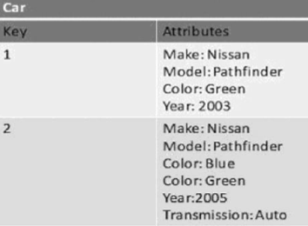
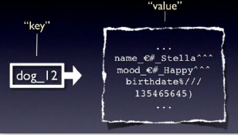
Key-Value Store
Main Idea is to use hash table
Access data (values) by strings call keys
Data has no required format
Data may have any format
Data Model: (key, value) pairs
Basic Operations
Insert(key, value)
Fetch(key)
Delete(key)
Execute(key, operation, parameters)
invoke an operation to the value (given its key) which is a special data structure (e.g. List, Set, Map .... etc)

Slide 42
Key-Value Store
Pros:
Very fast
Very scalable (horizontally distributed to nodes based on key)
Simple data model
Eventual consistency
Fault-tolerance
Cons:
Cannot model more complex data structure such as objects

Slide 43
Key-Value Store
Name | Producer | Data model | Querying
SimpleDB | Amazon | set of couples (key, {attribute}), where attribute is a couple (name, value) | restricted SQL; select, delete, GetAttributes, and PutAttributes operations
Redis | Salvatore Sanfilippo | set of couples (key, value), where value is simple typed value, list, ordered (according to ranking) or unordered set, hash value | primitive operations for each value type
Dynamo | Amazon | like SimpleDB | simple get operation and put in a context
Voldemort | LinkeId | like SimpleDB | similar to Dynamo

Slide 44
Key-Value Store
DynamoDB
Azure Table Storage
Riak
Rdis
Aerospike
FoundationDB
LevelDB
Berkeley DB
Oracle NoSQL Database
GenieDb
BangDB
Scalaris
Tokyo Cabinet/Tyrant
Scalien
Voldemort
Dynomite
KAI
MemcacheDB
Faircom C-Tree
LSM
KitaroDB
HamsterDB
STSdb
TarantoolBox
Maxtable
Quasardb
Pincaster
RaptorDB
TIBCO Active Spaces
Allegro-C
nessDB
HyperDex
SharedHashFile
Symas LMDB
Chordless
Sophia
PickleDB
Mnesia
LightCloud
Hibari
OpenLDAP
Genomu
BinaryRage
Elliptics
Dbreeze
RocksDB
TreodeDB

Slide 45
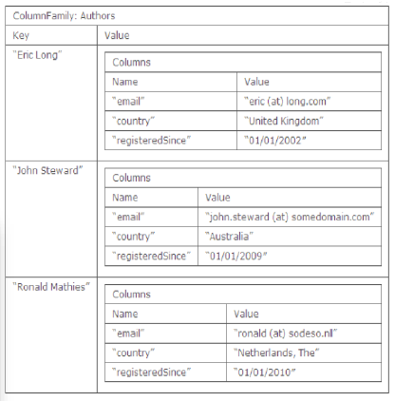
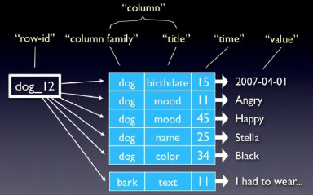
Column Databases
Column Databases are optimized for queries over large datasets, and store columns of data together, instead of rows.
The column is the lowest/smallest instance of data
Column databases are modeled on Google’s BigTable. The data model is based on a sparsely populated table whose rows can contain arbitrary columns

Slide 46
Column Databases
The basic data model can be seen as a two-level aggregate structure:
As with key-value stores, the first key is often described as a row identifier, picking up the aggregate of interest
This row aggregate is itself formed of a map of more detailed values. These second-level values are referred to as columns, each being a key-value pair
Column key consists of two parts – a column family, and a qualifier
a row is slice from a 3-dimensional cube
Flexible schema - the set of columns is not fixed, and may differ from row-to-row
Very sparse, most cells have null values
Operations are very primitive, and put the burden on the software for sophisticated processing.

Slide 47
Column Databases
Comparison: RDBMS vs column-based NOSQL
Query on multiple tables
RDBMS: must fetch data from several places on disk and glue together
Column-based NOSQL: only fetch column families of those columns that are required by a query (all columns in a column family are stored together on the disk, so multiple rows can be retrieved in one read operation → data locality)

Slide 48
Column Databases
Column families
Row key
Personal data
Professional data
ID | First Name | Last Name | Date of Birth | Job Category | Salary | Date of Hire | Employer
Column qualifiers

Slide 49
Column Databases
Personal data
Professional data
ID | First Name | Last Name | Date of Birth | Job Category | Salary | Date of Hire | Employer
ID | First Name | Middle Name | Last Name | Job Category | Employer | Hourly Rate
ID | First Name | Last Name | Job Category | Salary | Employer | Group | Seniority | Bldg # | Office #
ID | Last Name | Job Category | Salary | Date of Hire | Employer | Insurance ID | Emergency Contact
Medical data
One “table”

Slide 50
Column Databases
Row key
t₁
t₀
ID | First Name | Last Name | Date of Birth | Job Category | Salary | Date of Hire | Employer
Personal data
Professional data
One “row”
One “row” in a wide-column NoSQL database table
=
Many rows in several relations/tables in a relational database

Slide 51
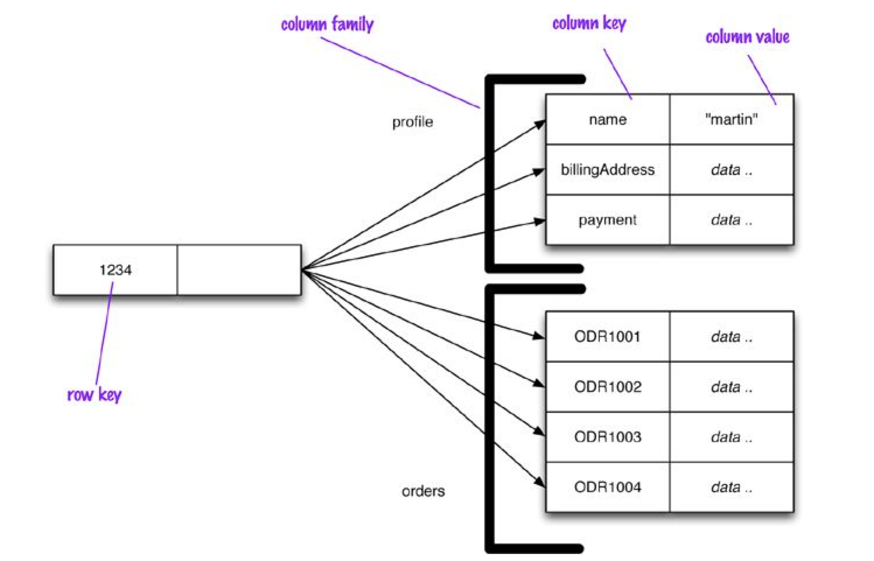
Column Databases: Example

Slide 52
Column Databases: Example
Row-oriented:
Each row is an aggregate (e.g. customer with the ID of 1234) of values
column families are useful chunks of data (profile, order history) within that aggregate
Column-oriented:
Each column family defines a record type (e.g., customer profiles) with rows for each of the records. You then think of a row as the join of records in all column families
Column Families can be then to some extent considered as tables in RDBMSs (but a Column Family can have different columns for each row it contains)

Slide 53
Column Databases
Example: (Cassandra column family--timestamps removed for simplicity)
UserProfile = {
Cassandra = { emailAddress:”casandra@apache.org” , age:”20”}
TerryCho = { emailAddress:”terry.cho@apache.org” , gender:”male”}
Cath = { emailAddress:”cath@apache.org” , age:”20”,gender:”female”,address:”Seoul”}
}

Slide 54

Column Databases
Some statistics about Facebook Search (using Cassandra)
MySQL > 50 GB Data
Writes Average : ~300 ms
Reads Average: ~350 ms
Rewritten with Cassandra > 50 GB Data
Writes Average : ~0.12 ms
Reads Average: ~15 ms

Slide 55
Column Databases
Name | Producer | Data model | Querying
BigTable | Google | set of couples (key, {value}) | selection (by combination of row, column, and time stamp ranges)
HBase | Apache | groups of columns (a BigTable clone) | JRUBY IRB-based shell (similar to SQL)
Hypertable | Hypertable | like BigTable | HQL (Hypertext Query Language)
CASSANDRA | Apache (originally Facebook) | columns, groups of columns corresponding to a key (supercolumns) | simple selections on key, range queries, column or columns ranges
PNUTS | Yahoo | (hashed or ordered) tables, typed arrays, flexible schema | selection and projection from a single table (retrieve an arbitrary single record by primary key, range queries, complex predicates, ordering, top-k)

Slide 56
Column Databases
Accumulo
Amazon SimpleDB
BigTable
Cassandra
Cloudata
Cloudera
Druid
Flink
Hbase
Hortonworks
HPCC
Hyupertable
KAI
KDI
MapR
MonetDB
OpenNeptune
Qbase
Splice Machine
Sqrrl

Slide 57
Document Databases
Document databases pair each key with a complex data structure known as a document.
Documents are stored in some standard format or encoding (e.g., XML, JSON, PDF, Office Documents, other semi-structured formats)
These are typically referred to as Binary Large Objects (BLOBs)
Flexible schema – subcomponent structure may be nested, and vary from document-to-document
Metadata – title, author, date, embedded tags, etc.
Examples: MongoDB, Apache SOLR, CouchDB (all can be queried using MapReduce)

Slide 58
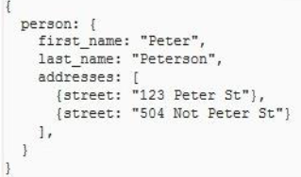
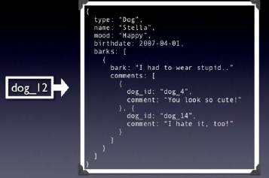
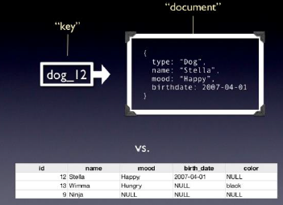
Document Databases
Data Model:
Pair each key with complex data structure known as data structure
Indexes are done via B-Trees
Documents can contain many different key-value pairs, key-array pairs, or even nested document

Slide 59
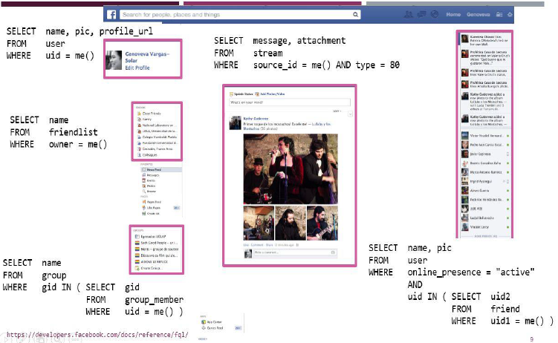
Document Databases

Slide 60
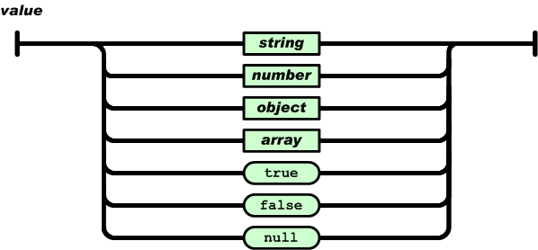


Document Databases
Example: (MongoDB) document
{Name:"Jaroslav",
Address:"Malostranske nám. 25, 118 00 Praha 1”,
Grandchildren: {Claire: "7", Barbara: "6", "Magda: "3", "Kirsten: "1", "Otis: "3", Richard: "1“}
Phones: [ “123-456-7890”, “234-567-8963” ]
}

Slide 61
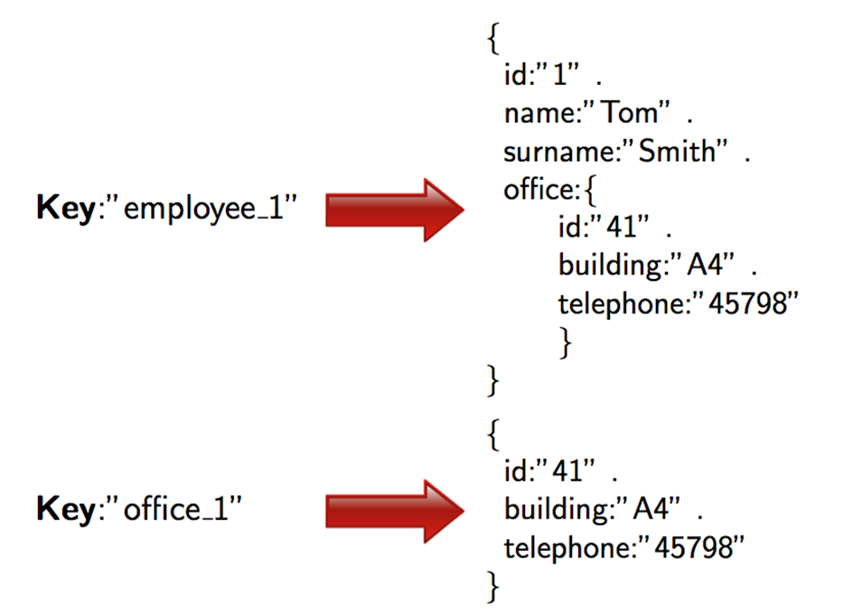
Document Databases
Example: (JSON) document

Slide 62
Document Databases Issues
Indexing: necessary for speed-up accesses
Indexes can be very big
Semantics problem still there:
Need for semantic extraction techniques

Slide 63
Document Databases
Name | Producer | Data model | Querying
MongoDB | 10gen | object-structured documents stored in collections; each object has a primary key called ObjectId |  | manipulations with objects in collections (find object or objects via simple selections and logical expressions, delete, update,)
Couchbase | Couchbase¹ | document as a list of named (structured) items (JSON document) |  | by key and key range, views via Javascript and MapReduce

Slide 64
Document Databases
AmisaDB
ArangoDB
BaseX
Cassandra
Cloudant
Clusterpoint
Couchbase
CouchDB
Densodb
Djondb
EJDB
Elasticsearch
eXist
FleetDB
iBoxDB
Inquire
JasDB
MarkLogic
MongoDB
MUMPS
NeDB
NoSQL embedded db
OrientDB
RaptorDB
RavenDB
RethinkDB
SDB
SisoDB
Terrastore
ThruDB

Slide 65

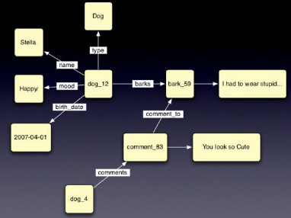
Graph Databases
Data model is based on graph Theory
Scales to the complexity of data
You can use graph algorithms easily
Can be used for both OLAP and OLTP
Optimized for transactional performance, and tend to guarantee ACID properties

Slide 66
Graph Databases
Focus on modeling the structure of data (interconnectivity)
Inspired by mathematical Graph Theory (G=(E,V))
Data Model:
(Directed Graphs) nodes and edges
Nodes may have properties (including ID)
Edges may have labels or roles
Key-value pairs on both
Interfaces and query languages vary
powerful for graph-like queries (e.g shortest path)
Examples: Neo4j, FlockDB, InfoGrid, VertexDB
Id:100
Label: knows
Since: 2001/10/03
Id: 2
Name: Bob
Age: 22
Id:101
Label: knows
Since: 2001/10/03
Id: 1
Name: Alice
Age: 18
Id:105
Label: is_member
Since: 2011/02/14
Id:104
Label: Members
Id:103
Label: Members
Id: 3
Name: Chess
Type: Group
Id:102
Label: is_member
Since: 2005/07/01

Slide 67
Graph Databases vs. Relational Databases
Suited to model real world situations where information is somehow “natively” in the form of a graph
social networks, recommendation systems, geospatial applications, computer network and data center management, authorization and access control, etc.
In these situations, relational databases lacks relationships: have to be simulated through the help of foreign keys, thus adding additional development and maintenance overhead, and “discover” them require costly join operations(Directed Graphs) nodes and edges

Slide 68
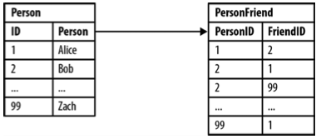
Graph Databases vs. Relational Databases
Example: Modeling friends and friends-of-friends in a relational database
PersonFriend is not considered symmetric. Bob may consider Zach as friend, but the converse does not necessarily hold
Asking “who are Bob’s friends?” (i.e., those that Bob considers as friend) is easy
SELECT p1.Person FROM Person p1 JOIN PersonFriend ON PersonFriend.FriendID = p1.ID JOIN Person p2 ON PersonFriend.PersonID = p2.ID WHERE p2.Person = 'Bob'

Slide 69
Graph Databases vs. Relational Databases
Things become more problematic when we ask, “who are the Alice’s friends-of-friends?”
SELECT p1.Person AS PERSON, p2.Person AS FRIEND_OF_FRIEND FROM PersonFriend pf1 JOIN Person p1 ON pf1.PersonID = p1.ID JOIN PersonFriend pf2 ON pf2.PersonID = pf1.FriendID JOIN Person p2 ON pf2.FriendID = p2.ID WHERE p1.Person = 'Alice' AND pf2.FriendID <> p1.ID
Performances deteriorate drastically when we try to explore more in depth into the network of friends

Slide 70
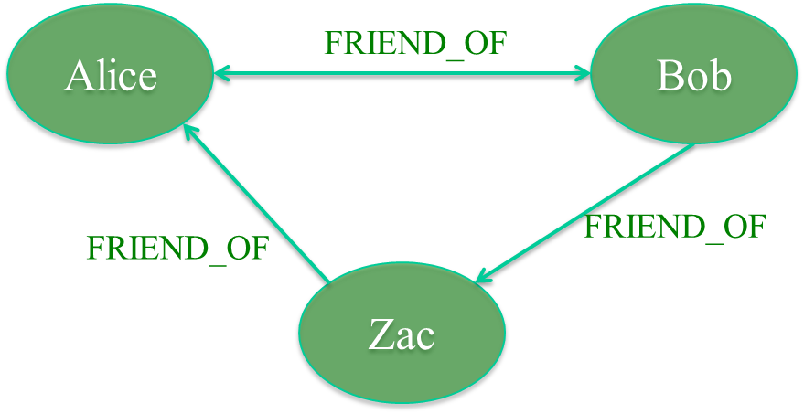
Graph Databases vs. Relational Databases
Modeling friends and friends-of-friends in a graph database
Relationships in a graph naturally form paths. Querying means actually traversing the graph, i.e., following paths. Because of the fundamentally path-oriented nature of the data model, the majority of path-based graph database operations are extremely efficient.

Slide 71
Graph Databases
AllegroGraph
ArangoDB
Bigdata
Bitsy
BrightstarDB
DEX/Sparksee
Execom IOG
Fallen *
Filament
FlockDB
ROIS
Sones GraphDB
SPARQLCity
Sqrrl Enterprise
GraphBase
Graphd
Horton
HyperGraphDB
IBM System G Native Store
InfiniteGraph
InfoGrid
jCoreDB Graph
MapGraph
Stardog
Teradata Aster
Titan
Trinity
Meronymy
Neo4j
Orly
OpenLink virtuoso
Oracle Spatial and Graph
Oracle NoSQL Datbase
OrientDB
OQGraph
Ontotext OWLIM
R2DF
TripleBit
VelocityGraph
VertexDB
WhiteDB

Slide 72
Most popular NoSQL database?
Vadim Ismakaev, Co-Founder at GraceUpdated Apr 27, 2015
Asking “what NoSQL database is the most popular” is a bit incorrect since different problems require different types of NoSQL solutions. …focus on solving very specific problems. While this allows to achieve the best possible results in those specific cases, it comes at a cost of some other functionalities.
[https://www.quora.com/Whats-the-most-popular-NoSQL-database]

Slide 73
Ranking DB Engines?
We measure the popularity of a system by using the following parameters:
Number of mentions of the system on websites, …
General interest in the system. For this measurement, we use the frequency of searches in Google Trends.
Frequency of technical discussions about the system... Stack Overflow …
Number of job offers, in which the system is mentioned...
Number of profiles in professional networks, in which the system is mentioned... LinkedIn …
Relevance in social networks. We count the number of Twitter tweets, in which the system is mentioned.

Slide 74
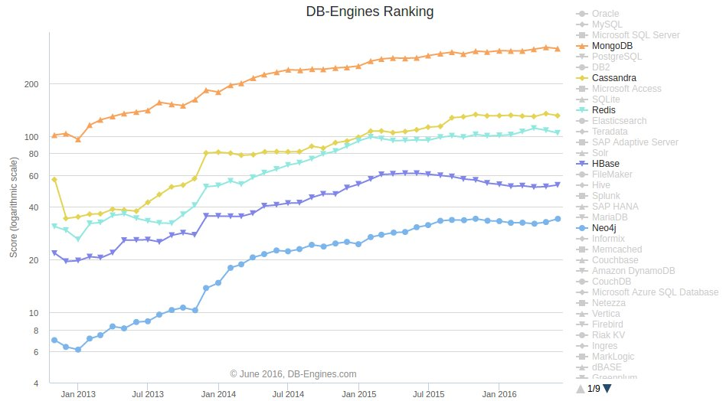
Ranking DB Engines? NoSQL
Document databases: MongoDB Wide-column stores: Cassandra and Hbase key-value: Redis Graph database: Neo4j
[http://www.kdnuggets.com/2016/06/top-nosql-database-engines.html]

Slide 75
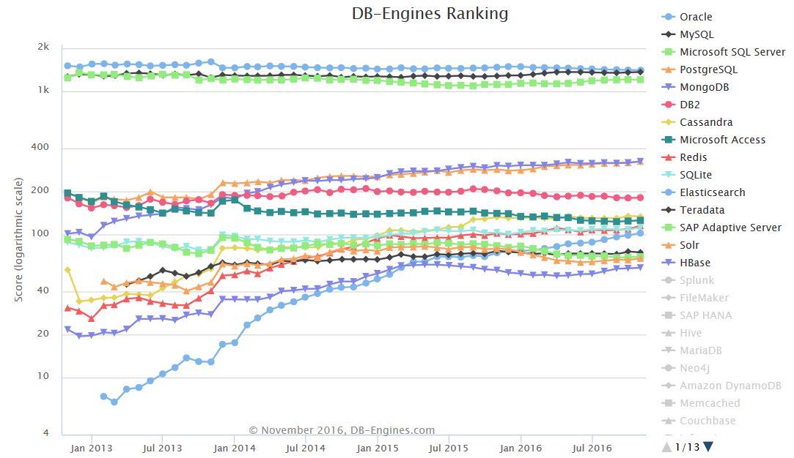
Ranking DB Engines?
The DB-Engines Ranking ranks DBMS according to their popularity – not only NOSQL databases
[http://db-engines.com/en/ranking_trend]

Slide 76
Summary: Schemaless NoSQL Databases
A key-value store allows you to store any data you like under a key
A document database effectively does the same thing, since it makes no restrictions on the structure of the documents you store
Column-family databases allow you to store any data under any column you like
Graph databases allow you to freely add new edges and freely add properties to nodes and edges as you wish

Slide 77
Summary: Schemaless NoSQL Databases
Without a schema binding you, you can easily store whatever you need, and change your data storage as you learn more about your project
You can easily add new things as you discover them
A schemaless store also makes it easier to deal with non-uniform data: data where each record has a different set of fields (limiting sparse data storage)

Slide 78
Summary: Schemaless NoSQL Databases
Indeed, a program that accesses data almost always relies on some form of implicit schema: it will assume that certain field names are present and carry data with a certain meaning, and assume something about the type of data stored within that field
Having the implicit schema in the application means that in order to understand what data is present you have to dig into the application code
Furthermore, the database remains ignorant of the schema: it cannot use the schema to support the decision on how to store and retrieve data efficiently.
Also, it cannot impose integrity constraints to maintain information coherent

Slide 79
What we need?
We need a distributed database system having such features:
Fault tolerance
High availability
Consistency
Scalability
Which is Impossible!!!
According to CAP theorem:

Slide 80
The CAP Theorem
The limitations of distributed databases can be described in the so called the CAP theorem by Prof. Eric Brewer
Consistency: every node always sees the same data at any given instance (i.e., strict consistency)
Availability: the system continues to operate, even if nodes in a cluster crash, or some hardware or software parts are down due to upgrades. Reads and writes always succeeds
Partition Tolerance: the system continues to operate in the presence of network partitions when network failures prevent some machines from communicating with others
CAP theorem: any distributed database with shared data, can have at most two of the three desirable properties, C, A or P

Slide 81
The CAP Theorem
Let us assume two nodes on opposite sides of a network partition:
Availability + Partition Tolerance forfeit Consistency
Consistency + Partition Tolerance entails that one side of the partition must act as if it is unavailable, thus forfeiting Availability
Consistency + Availability is only possible if there is no network partition, thereby forfeiting Partition Tolerance

Slide 82
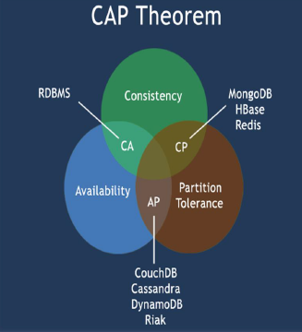
The CAP Theorem

Slide 83
The CAP Theorem
A consistency model determines rules for visibility and apparent order of updates. For example:
Row X is replicated on nodes M and N
Client A writes row X to node N
Some period of time t elapses
Client B reads row X from node M
Does client B see the write from client A?
Consistency is a continuum with tradeoffs
For NOSQL, the answer would be: “maybe”
CAP theorem states “strong consistency can’t be achieved at the same time as availability and partition-tolerance”

Slide 84
The CAP Theorem: Why is it important?
The future of databases is distributed (Big Data Trend, etc.)
CAP theorem describes the trade-offs involved in distributed systems
A proper understanding of CAP theorem is essential to making decisions about the future of distributed database design
Misunderstanding can lead to erroneous or inappropriate design choices

Slide 85
Large-Scale Databases
When companies such as Google and Amazon were designing large-scale databases, 24/7 Availability was a key
A few minutes of downtime means lost revenue
When horizontally scaling databases to 1000s of machines, the likelihood of a node or a network failure increases tremendously
Therefore, in order to have strong guarantees on Availability and Partition Tolerance, they had to sacrifice “strict” Consistency (implied by the CAP theorem)

Slide 86

Trading-off Consistency
Maintaining consistency should balance between the strictness of consistency versus availability/scalability
Good-enough consistency depends on your application
Loose Consistency
Strict Consistency
Easier to implement, and is efficient
Generally hard to implement, and is inefficient

Slide 87
The ACID properties
The CAP theorem proves that it is impossible to guarantee strict Consistency and Availability while being able to tolerate network partitions
This resulted in databases with relaxed ACID guarantees
Atomicity: every transaction is executed in “all-or-nothing” fashion
Coherence (or consistency): every transaction preserves the coherence with constraints on data (i.e., at the end of the transaction constraints are satisfied by data)
Isolation: transaction does not interfere. Every transaction is executed as it was the only one in the system (every seralization of concurrent transactions is accepted)
Durability: after a commit, the updates made are permanent regardless possible failures

Slide 88
The BASE properties
With relaxed ACID guarantees, NoSQL databases follow the BASE properties:
Basically Available: the system guarantees Availability
Soft-State: the state of the system may change over time
Eventual Consistency: the system will eventually become consistent

Slide 89
Eventual Consistency
A database is termed as Eventually Consistent if:
All replicas will gradually become consistent in the absence of updates
Webpage-A
Example:
Web Caching
DNS
Trait:
Optimistic
Expiration/Time-to-live
Conflict resolution
Webpage-A
Webpage-A
Webpage-A
Webpage-A
Webpage-A
Event: Update Webpage-A
Webpage-A
Webpage-A
Webpage-A
Webpage-A
Webpage-A
Webpage-A

Slide 90
Eventual Consistency: A Main Challenge
But, what if the client accesses the data from different replicas?
Protocols like Read Your Own Writes (RYOW) can be applied!
Webpage-A
Webpage-A
Webpage-A
Webpage-A
Webpage-A
Webpage-A
Event: Update Webpage-A
Webpage-A
Webpage-A
Webpage-A
Webpage-A
Webpage-A
Webpage-A

Slide 91



Eventual Consistency: A Facebook Example
Bob finds an interesting story and shares with Alice by posting on her Facebook wall
Bob asks Alice to check it out
Alice logs in her account, checks her Facebook wall but finds:
Nothing is there!
?

Slide 92

Eventual Consistency: A Facebook Example
Bob tells Alice to wait a bit and check out later
Alice waits for a minute or so and checks back:
She finds the story Bob shared with her!

Slide 93
Eventual Consistency: A Facebook Example
Reason: it is possible because Facebook uses an eventual consistent model
Why Facebook chooses eventual consistent model over the strong consistent one?
Facebook has more than 1 billion active users
It is non-trivial to efficiently and reliably store the huge amount of data generated at any given time
Eventual consistent model offers the option to reduce the load and improve availability

Slide 94

Eventual Consistency: An ATM Example
In design of automated teller machine (ATM):
Strong consistency appear to be a nature choice
However, in practice, A beats C
Higher availability means higher revenue
ATM will allow you to withdraw money even if the machine is partitioned from the network
However, it puts a limit on the amount of withdraw (e.g., $200)
The bank might also charge you a fee when a overdraft happens

Slide 95



Eventual Consistency: An Dropbox Example
Dropbox enabled immediate consistency via synchronization in many cases. However, what happens in case of a network partition?
Let’s do a simple experiment here:
Open a file in your drop box
Disable your network connection (e.g., WiFi, 4G)
Try to edit the file in the drop box: can you do that?
Re-enable your network connection: what happens to your dropbox folder?

Slide 96
Eventual Consistency: An Dropbox Example
Dropbox embraces eventual consistency:
Immediate consistency is impossible in case of a network partition
Users will feel bad if their word documents freeze each time they hit Ctrl+S , simply due to the large latency to update all devices across WAN
Dropbox is oriented to personal syncing, not on collaboration, so it is not a real limitation.

Slide 97
Dynamic Tradeoff between C and A
An airline reservation system:
When most of seats are available: it is ok to rely on somewhat out-of-date data, availability is more critical
When the plane is close to be filled: it needs more accurate data to ensure the plane is not overbooked, consistency is more critical
Neither strong consistency nor guaranteed availability, but it may significantly increase the tolerance of network disruption

Slide 98
Consistency or Availability
Consistency and Availability is not “binary” decision
AP systems relax consistency in favor of availability – but are not inconsistent
CP systems sacrifice availability for consistency- but are not unavailable
This suggests both AP and CP systems can offer a degree of consistency, and availability, as well as partition tolerance
C
A
P

Slide 99
ACID vs. BASE properties
Where ACID is pessimistic and forces consistency at the end of every operation, BASE is optimistic and accepts that the database consistency will be in a state of flux
Basically Available: The availability of BASE is achieved through supporting partial failures without total system failure.
Soft state: data are “volatile” in the sense that their persistence is in the hand of the user that must take care of refreshing them
Eventual Consistency: the system eventually converge to a consistent state

Slide 100
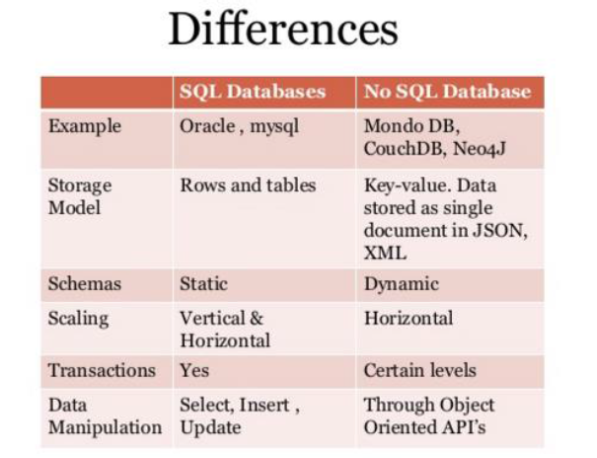
SQL vs NoSQL

Slide 101
Summary
Most modern NoSQL systems diverge from the relational model or standard RDBMS functionality:
In that sense, NoSQL today is more commonly meant to be something like “non-relational”
The data model: relations documents
tuples vs. graphs
attributes key/values
domains
normalization
The query model: relational algebra graph traversal
tuple calculus vs. text search
map/reduce
The implementation: rigid schemas vs. flexible schemas
(schema-less)
ACID compliance vs. BASE

Slide 102
Summary
RDBMS is a great tool for solving ACID problems
When data validity is super important
When you need to support dynamic queries
NoSQL is great tool for solving data availability problems
When it’s more important to have fast data than right data
When you need to scale based on changing requirements
Pick the right tool for the job

